Slide 1
19Z502 Microprocessors and Interfacing
Assessment Tutorial Questions
Dr.N.Arulanand
CSE, PSG CT

Slide 2
Test 1
Program to swap the contents of two registers without using another register
Program: Implement the loop, with the counter = 19
List the various flags in the flag register. Mention flagname (short form) and abbreviation
If the original contents of AX, CL, and CF are 800FH, 04H, and 1, respectively, what is the content of AX and CF after executing the instruction that follows:
SAR AX,CL
5. AL has content of 05H. What is result of NEG and NOT on AL ?
6. If DS=2000H, ES=3000H, BX=1000H, SI=2000H. From which location AH will copy the value
MOV AH,[BX][SI] + 1234H

Slide 3
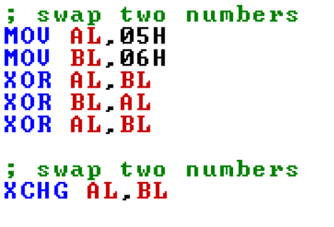
Question 1:

Slide 4
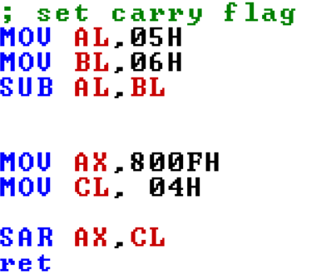
Question 3:
Answer:

Slide 5
Question 5
Ans: NEG 05 → FBH
Ans: NOT 05 → FAH

Slide 6
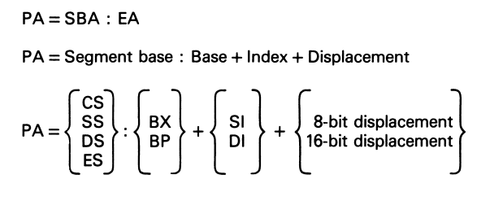



Question 6
Physical Address (PA) = Segment Base Address (SBA) + Effective Address (EA)

Slide 7
Write equivalent instruction sequences using string instructions for this:
MOV AL,[DI]
CMP AL,[SI]
DEC SI
DEC DI
2. What happens to the ZF and CF status flags as the following sequence of instructions is executed ? Assume that they are both initially cleared.
MOV BX,1111H
MOV AX,0BBBBH
CMP BX,AX
3. Find the greatest of three numbers. Store the result in AX register
4.Write a program that saves bit 5 of AL in BX as a word
(NOTE: In a byte, bit 0 is the Least Significant Bit and bit 7 is the Most Significant Bit)
5. If AL contains A0H, what happens when the instruction CBW is executed ?

